Slide 1
Applying Colour Theory/Knowledge
Summative Task

Slide 2
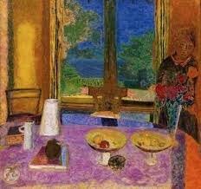
Pierre Bonnard Dining Room on the Garden 1967

Slide 3
Howard Hodgkin Home, Home on the Range, 2001-2007
http://db-artmag.com/en/62/feature/howard-hodgkin-the-secret-of-color/

Slide 4
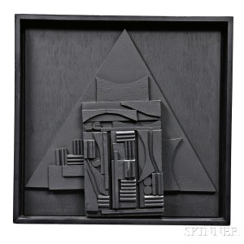
Louise Berlianwsky Nevelson (1899-1988) Relief Sculpture

Slide 5
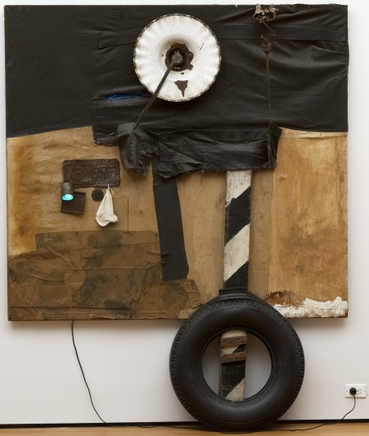
Robert Rauschenberg, First Landing Jump. 1961. Cloth, metal, leather, electric fixture, cable, and oil paint on composition board, with automobile tire and wood plank. The Museum of Modern Art, New York.

Slide 6
Task: Criterion A,B,C and D
You will have to show you have understood how to control colour, you will have to make a skillful piece of work that combines painting and relief sculpture, you will have to show you have a plan, and you will have to show you are reflecting on your progress as you go and at the end.

Slide 7
The Brief
Plan to make an artwork, (roughly A4 in size) based on an image of an Omani door or window, that has some sculptural relief elements and shows control of colour (you can very imaginative about this). Write success criteria.
Action your plan – the final piece should not be just a ‘copy’ of the source image but must be a ‘creative development’ of the image.
Keep a record of your progress and process on your website.
Write regular short formative reflections and a summative reflection that considers how well you have met your success criteria.

