Slide 1
Subjective Objects
The meaningfulness of things.

Slide 2
sub·jec·tive
səbˈjektiv/
adjective
1.
based on or influenced by personal feelings, tastes, or opinions.
"his views are highly subjective"
  2.
ob·jec·tive
əbˈjektiv/
adjective
adjective: objective
1.
(of a person or their judgment) not influenced by personal feelings or opinions in considering and representing facts.
"historians try to be objective and impartial"
synonyms: | impartial, unbiased, unprejudiced, nonpartisan, disinterested, neutral, uninvolved, even-handed, equitable, fair, fair-minded, just, open-minded, dispassionate, detached, neutral"I was hoping to get an objective and pragmatic report"

Slide 3
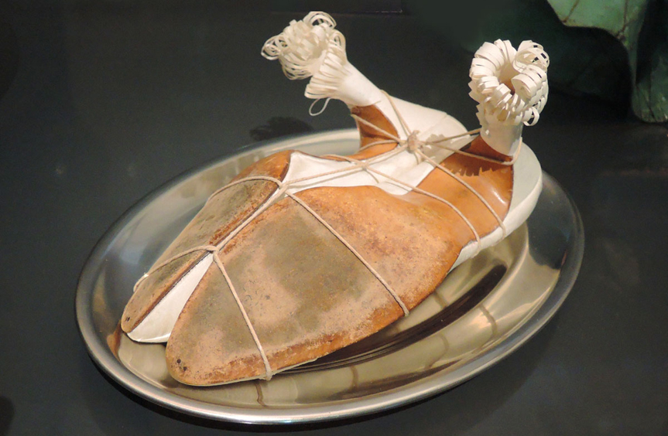
Meret Oppenheimer http://www.promostyl.com/blog/en/dreaming-about-meret-oppenheim/

Slide 4
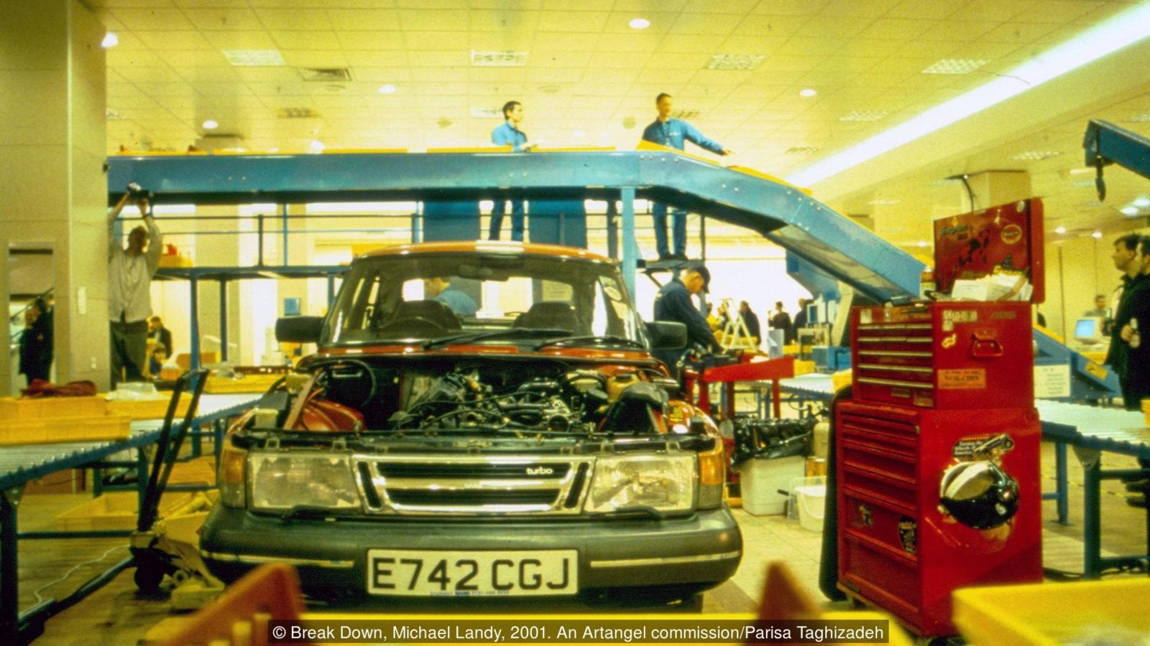
Michael Landy http://www.bbc.com/culture/story/20160713-michael-landy-the-man-who-destroyed-all-his-belongings

Slide 5

https://www.khanacademy.org/humanities/ancient-art-civilizations/roman/wall-painting/a/still-life-with-peaches

Slide 6

https://en.wikipedia.org/wiki/Pieter_Claesz

Slide 7

http://www2.tate.org.uk/imap/imap2/leger.shtml

Slide 8
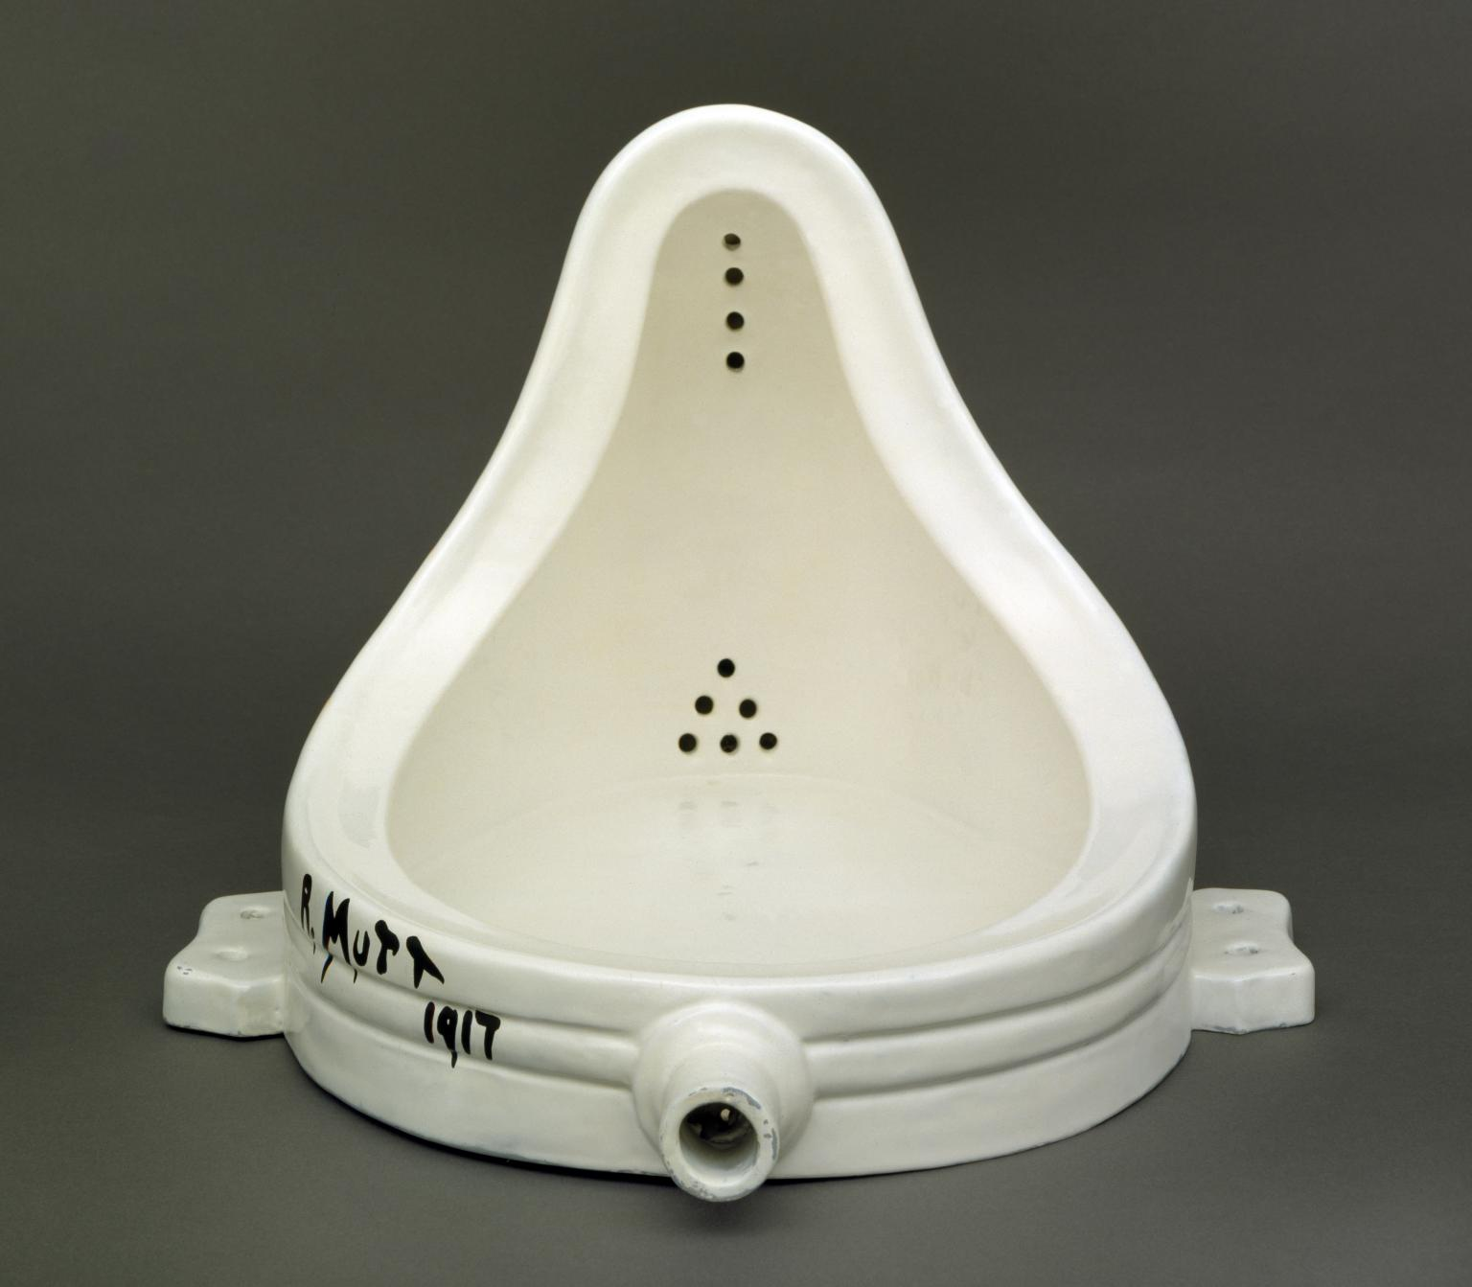
http://www.tate.org.uk/art/artworks/duchamp-fountain-t07573

