Slide 1
Perception
What does this word mean?

Slide 2
McGurk Effect
Sometimes our perception of reality cannot be trusted.
For us as artists this means we have to ask questions about what we intend when we say we want to show something ‘realistically’
is your red the same as my red?
Important Vocabulary:
Subjective = how you as an individual experience something
Objective = something that is factual and not dependent on individual experience.

Slide 3
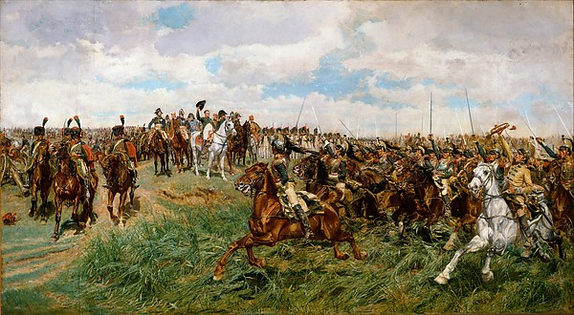
This work, the largest and most ambitious painting by an artist renowned for meticulously rendered cabinet pictures, evokes one of Napoleon Bonaparte’s greatest victories. Meissonier made hundreds of preparatory studies for it, including drawings and sculptural models. The present work gained notoriety in 1876, when the American department store magnate Alexander T. Stewart purchased it from the artist, sight unseen, for the then astronomical sum of $60,000.
Friedland, 1807
Ernest Messonier
http://www.metmuseum.org/art/collection/search/437052
60000 USD in 1876 worth today?

Slide 5
Realism? Realistic?
What is realistic in this painting?
Does the painting look like how you see the world?
How is it different from how the world looks?

Slide 6
impact on our world of photography
those horses .....
So what is an artist to do if we question the idea of objective reality…..?
“When you go out to paint, try to forget what objects you have in front of you, a tree, a field…Merely think, here is a little square of blue, here an oblong of pink, here a streak of yellow, and paint it just as it looks to you, the exact color and shape, until it gives your own naïve impression of the scene.”
Claude Monet
Impression, sunrise by Monet

Slide 7
Short investigation task to develop an informed opinion
What was Monet trying to achieve in his impressionist paintings? (summarise what impressionist painting was and what Monet intended in his work)
Post an image of impressionist paintings ( from France in the 19th century) that are examples for each letter of ELBOW ( Everyday life, Light, Brushwork, Outdoors, Weather) on your website on a page titled " Impressionism and Perception". CITE YOUR SOURCES!
Define the term perception and then write your opinion about whether impressionist painting does indeed come closer to our visual experience of the world than other ‘realistic’ painting styles? (you will need to include cited visual images and/or research references to support your opinion.)
Resources:
https://www.khanacademy.org/humanities/becoming-modern/avant-garde-france/impressionism/a/a-beginners-guide-to-impressionism
http://www.theartstory.org/movement-impressionism.htm
https://artisticideas2011.wordpress.com/2011/03/22/writing-like-impressionism-a-similie-to-reality/

Slide 8
Things to be aware of…
In your own words – do not cut and paste - I will be checking.
Any image or information must be cited as a reference – in FULL.
Presentation is important – make your work easy to navigate on your website.
The last task asks you to offer an informed opinion - you will need to justify your opinion with examples and/or other research material. You are being asked to decide if impressionist painting depicts reality more than other styles of painting – you will need to explain your reasons for your opinion.

