Slide 1
In Depth
Grade 8 MYP 3
Unit 2

Slide 2
1440 Paulo Ucello The Rout of San Romano https://www.nationalgallery.org.uk/paintings/paolo-uccello-the-battle-of-san-romano

Slide 3
https://archiobjects.org/the-ideal-city-in-three-renaissance-paintings/

Slide 4
The problem of binocular vision https://heartland-eye.com/binocular-vision-disorders/

Slide 5
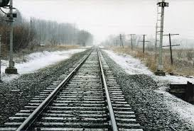
Our ATL is Scientific and Technical Innovation – so was perspective invented?
https://www.khanacademy.org/humanities/renaissance-reformation/early-renaissance1/beginners-renaissance-florence/v/linear-perspective-brunelleschi-s-experiement

Slide 6
Seeing is believing – string…...
One point perspective
Two point perspective
Three point perspective
Vanishing points ‘off’ the picture plane
First individual task: on a surface you have chosen/prepared and using two or three point perspective produce an artwork that demonstrates you can use, and have fun with, liner perspective.

Slide 7
http://www.meganharrison.net/Untitled-project-2

