Slide 1
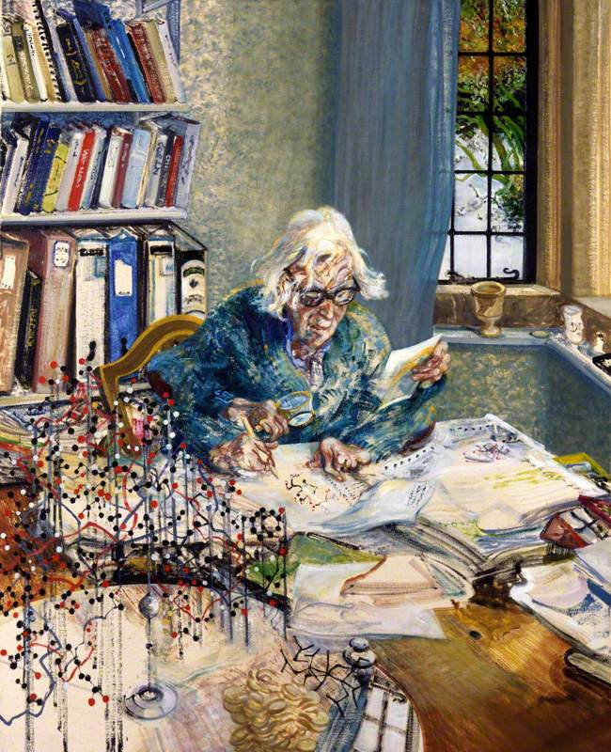
‘looks like’? Or ‘Is like’?
Maggi Hambling
Portrait of Dorothy Hodgkin 1985

Slide 2
Frida Kahlo ‘Diego in my thoughts’ 1943

Slide 3
Vincent Van Gogh 1890 ‘wheatfield with crows’

Slide 4
http://marcquinn.com/artworks/self

Slide 5
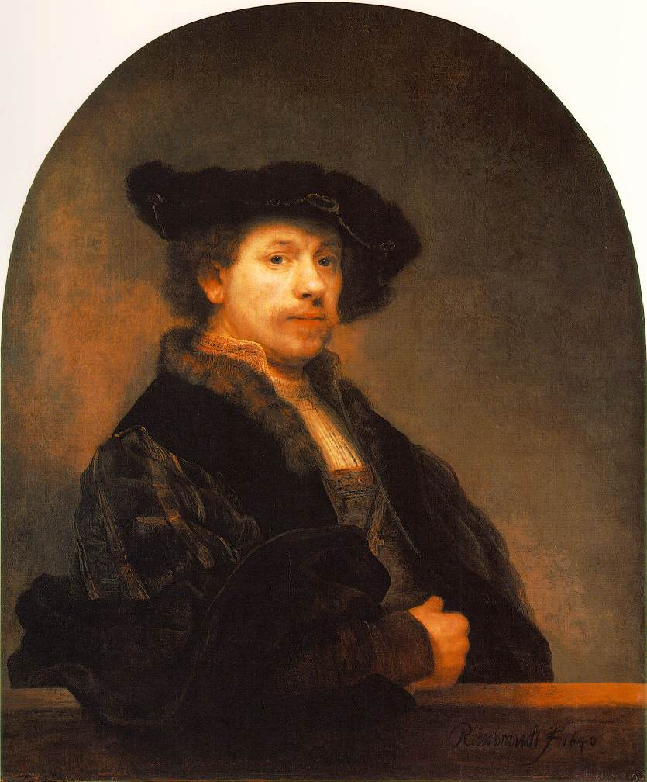
Rembrandt Van Rjinn 1660’s

Slide 6
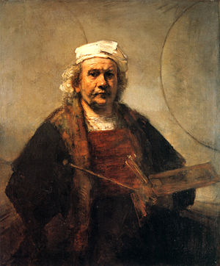

Slide 8
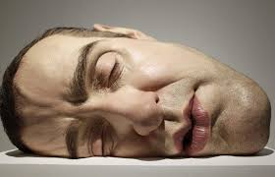
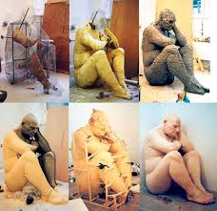
Ron Mueck

Slide 9
Howard Hodgkin ‘portrait of the artist listening to music” March 2017

Slide 10
Howard Hodgkin ‘Blue portrait” 2012

Slide 11
Ann Gale “Self-portrait with Collar," 2014,

Slide 12
Edvard Munch The Scream 1893 "I was walking down the road with two friends when the sun set; suddenly, the sky turned as red as blood. I stopped and leaned against the fence, feeling unspeakably tired. Tongues of fire and blood stretched over the bluish black fjord. My friends went on walking, while I lagged behind, shivering with fear. Then I heard the enormous infinite scream of nature."

Slide 13
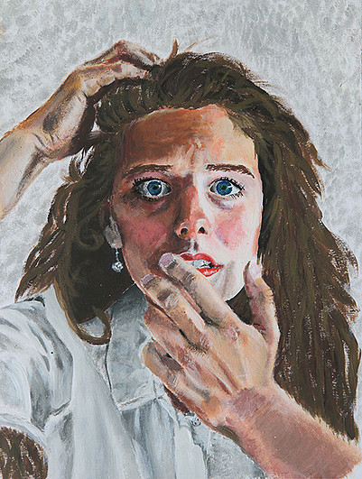
Gustav Courbet ‘The Desperate man’ self portrait 1843

Slide 14
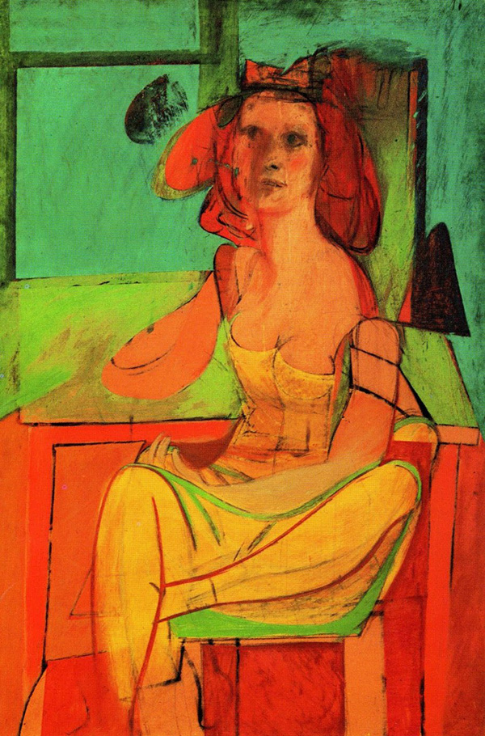
Willem De Kooning 1940 and 1950

Slide 15
Now…..
http://www.complex.com/style/2012/10/25-awesome-contemporary-portrait-artists/

Slide 16
What can a portrait communicate?
Likeness – showing what you perceive, representational, objective
Information about the model/sitter– what the person does for a living, what they care about, what they think about
Information about the artist– what the artist thinks or feels about the person
Inquiry – the act of looking so intently at someone, or ourselves leads to questions…....

