Slide 1
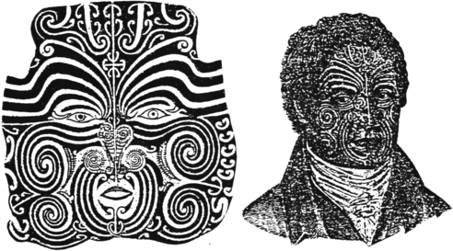
Western vs. Non-western
Both images depict a portrait of a Maori chieftain, one by the chieftain himself (left) and one by a European artist (right).
Both show his facial tattoos, however the European artist, John Sylvester, shows the head and shoulders and downplays the graphic elements of the tattoos. He also portrays the king as an English gentleman with western style clothes and hair style. The chieftain, Te Pehi Kupe, chose to highlight the stark shapes and design of the tattoos while undermining the human features. In his self-portrait, the King portrays himself in a more basic form and less linked to the westernized culture.

Slide 2
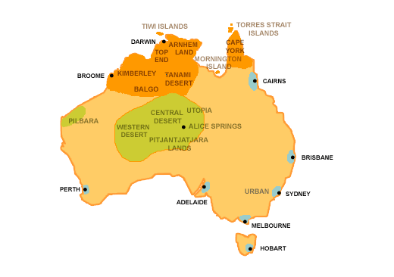
Aboriginal Art

Slide 3
Aboriginal Art
Aborigines are the native people of Australia.
Their art is characterized by interlocking shapes and stylized images.
Aboriginal art is very different from western art styles. It involves different perspectives, shapes, and methods.
Despite European settlement in the region, Aboriginal art has survived into modern times.

Slide 4
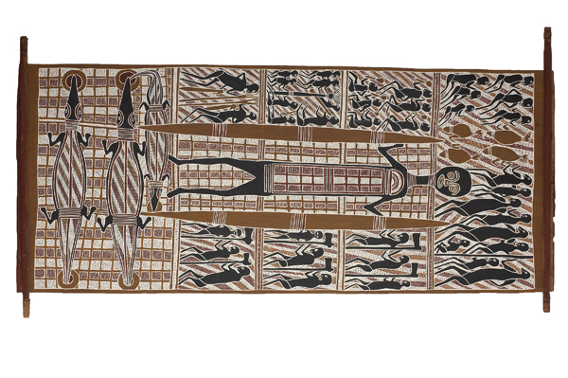
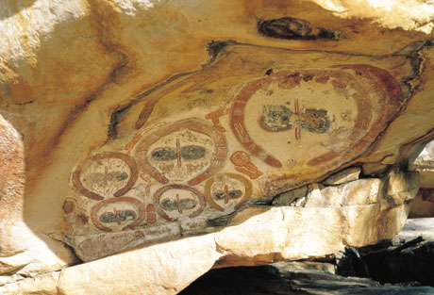
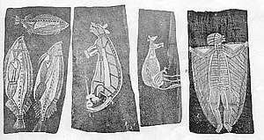
Aboriginal Art: Natural Mediums
Natural pigments used to dye and paint natural surfaces

Slide 5
Aboriginal Art: Patterns
Aboriginal art often is characterized by earth tones, images shown from above or in profile, and simple organic shapes.
They also often involve repeated patterns, with concentric circles and horizontal lines. These patterns represent different symbols of the aboriginal culture and history.
Images are often hidden within the seemingly simple shapes.

Slide 6
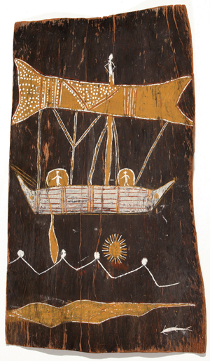
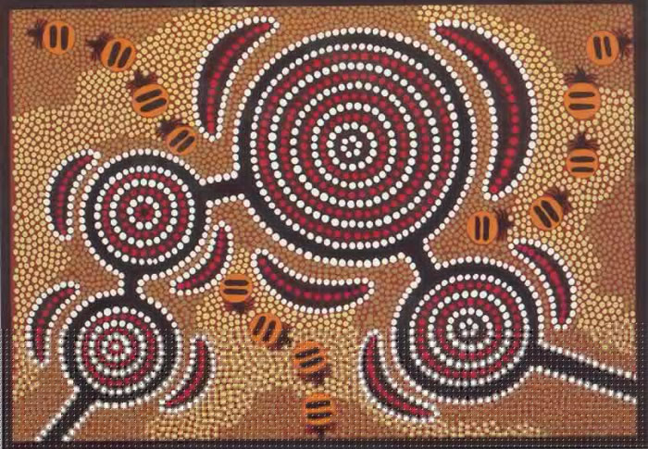
Aboriginal Art: Patterns

Slide 7
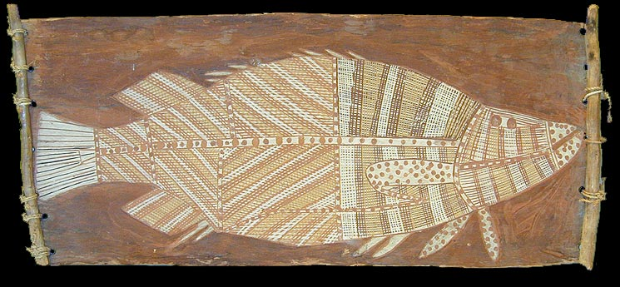
Aboriginal Art: X-Ray Style
X-Ray style of Aboriginal art was developed to show the every aspect of the artist subject. In addition to outlining the basic shape inner parts of animals and people may also be included in the image.

Slide 8
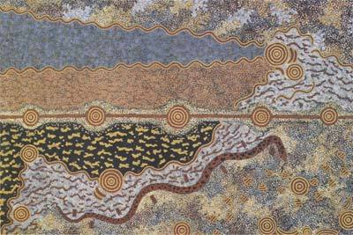
Aboriginal Art: Journeys
Aboriginal Art often depicts a journey or acts as a sort of map.
Multiple focal points, and overhead point of view are used to act as a guide.

Slide 9
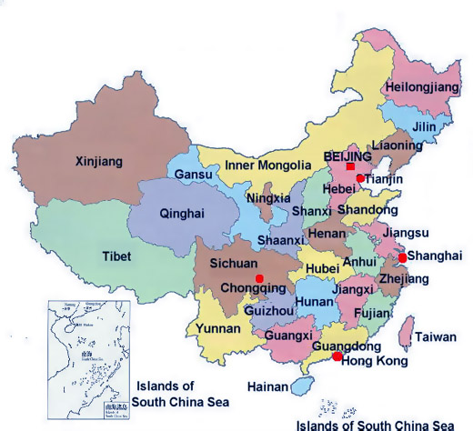
Chinese Art

Slide 10
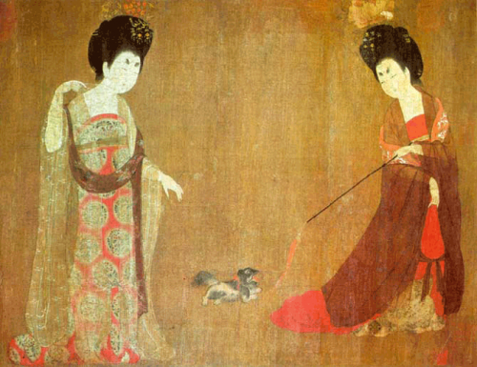
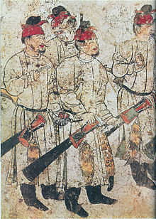
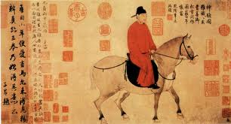
Chinese Art: Court Style

Slide 11
Chinese Portraits during the Court Style period in art – Ching Dynasty
Only the members of the court were
In this manner, Emphasis was on
Attempting to create a likeness so
The people viewing the image would
Know it was the emperor
Although the emperor sat in front of
The artist –
Artists did not use
Perspective, anatomy, foreshortening,
Chiaroscuro ( light and dark) like western artists
The figure is seen here as all important
As the background is a flat gold color
Artist unknown
Date - Middle Ages in Europe

Slide 12
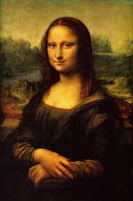
Western Portaiture 1504-1912
Mona Lisa by Da Vinci- 1503- 1506
Drawn from life
Atmospheric or aerial perspective
Chiaroscuro
Knowledge of Anatomy
Sfumato- blurring of edges so that the eyes, nose, mouth
And hands are in focus but as you go
Back in space the figure is softer – hence further
Away
The background is imaginary and does not
Match from the left to right side
Oil on Panel

Slide 13
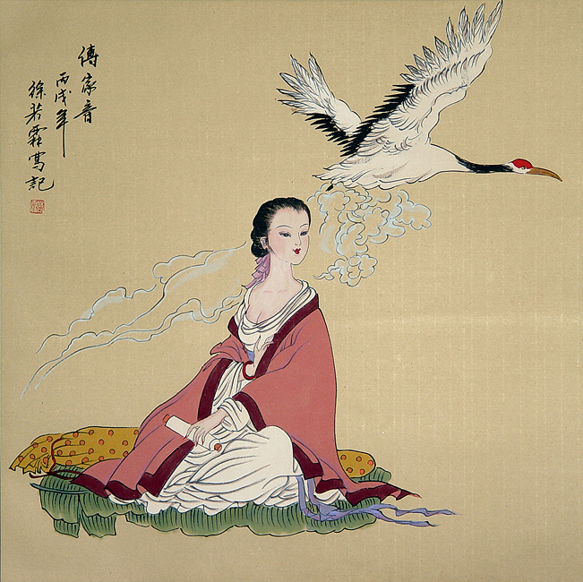
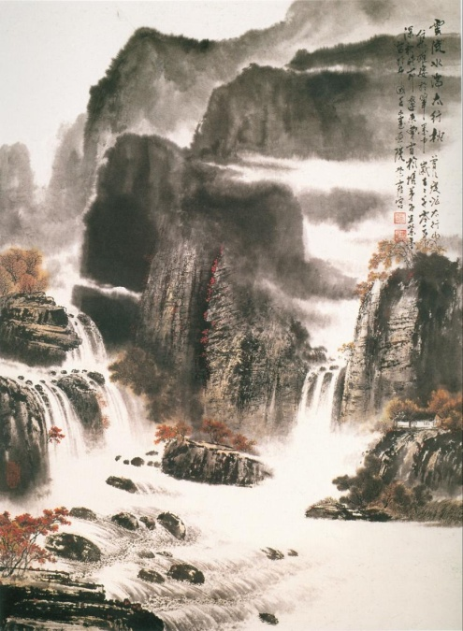
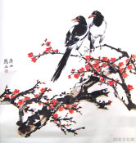
Chinese Art: Subject Matter
By the end of the Tang Dynasty the subject matter of most Chinese paintings had been narrowed to three main groups: figure, landscape, and bird/flower paintings.

Slide 14
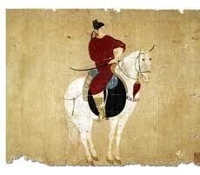
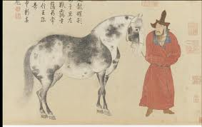
Scholar painting in Chinese Art during the Yuan to Ming Dynasty
Time frame is Yuan-1279-1368
Ming Dynasty- 1368-1644
These are sections
From hand-scrolls
Asymmetrical
Ink and Color
No reference to
Background- flat
Lack of proportion
A Horse and Groom in Red Coat – Yuan Dynasty

Slide 15
Chinese Landscape Yuan and Tang Dynasties
Lotus Pond and Waterfowl
Lotus represents hope and purity
Cranes symbolize good luck and long life
This painting is stylized ( abstracted ) and the background
Is flat
Hanging scroll ink and color

Slide 16
Chinese painting Ching dynasty
Chinese painters prefer to capture
The ESSENCE of a subject so many
Details are left out
They work from memory and
Enjoy the concept of uncluttered
Space
A well ordered garden symbolizes
Harmony in the universe
Certain plants symbolize virtues

Slide 17
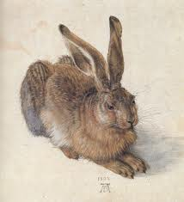
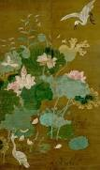
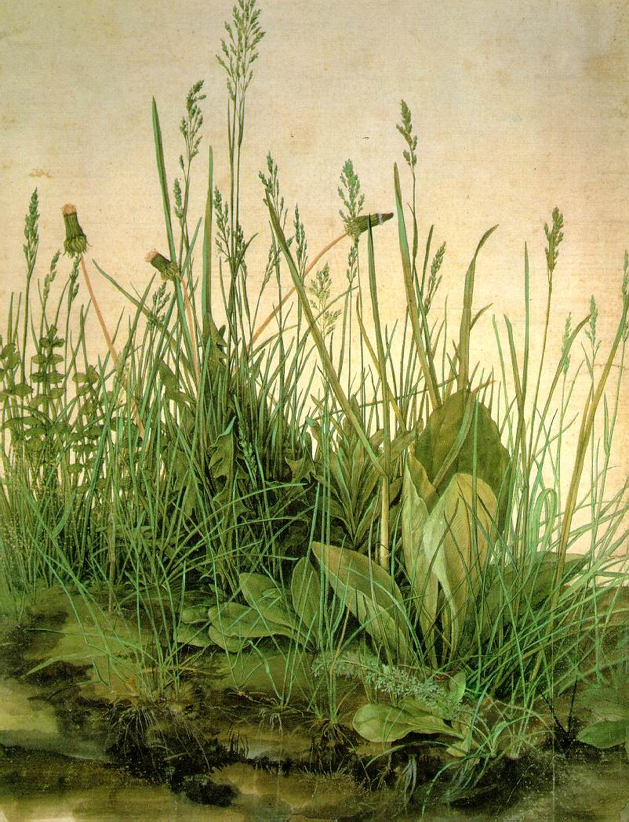
Western VS Non Western

Slide 18
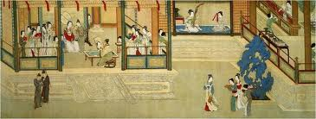
Spring Morning in the Han Palace Ming Dynasty-1494- 1552
What is important to the artist? What is meant by hierarchical perspective?
Is there a light source, use of proportion, anatomy, or one point perspective?
This is painted on a scroll that unrolls to show each scene. What is the story
Behind this painting? Court life and every day activities .

Slide 19
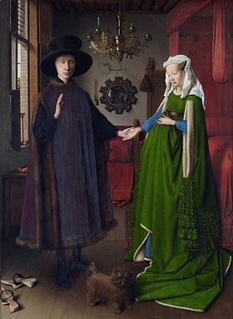
Interior Northern Renaissance

Slide 20
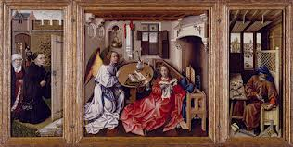
Northern Renaissance Interior Painting

Slide 21
http://www.chinaonlinemuseum.com/painting-qiu-ying-han-palace.php
Spring Morning in the Han Palace- Ming Dynasty
- 1494-1552
( Same time frame and the Italian Renaissance)

Slide 22
Chinese Art: Natural Influence
Later, Chinese Art was more centrally focused on landscape as a subject matter.
The popularity of vast landscapes came about after the Tang Dynasty with the rise of Daoism. Daoism considers humans to be a small part in the workings of a complex and interactive natural world.
These Dao influenced paintings are characterized by intricate and large elements of nature, small figures, open negative space, and flowing movement.
Figures are often still a part of these paintings but are fairly small and insignificant to highlight that humans are a small part of a vast and ever-changing universe;

Slide 23
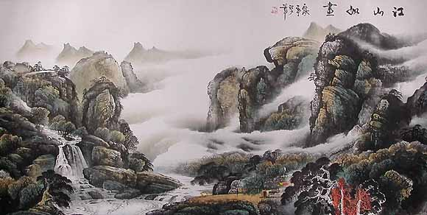
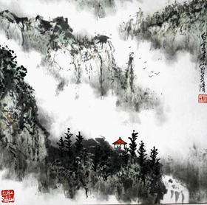
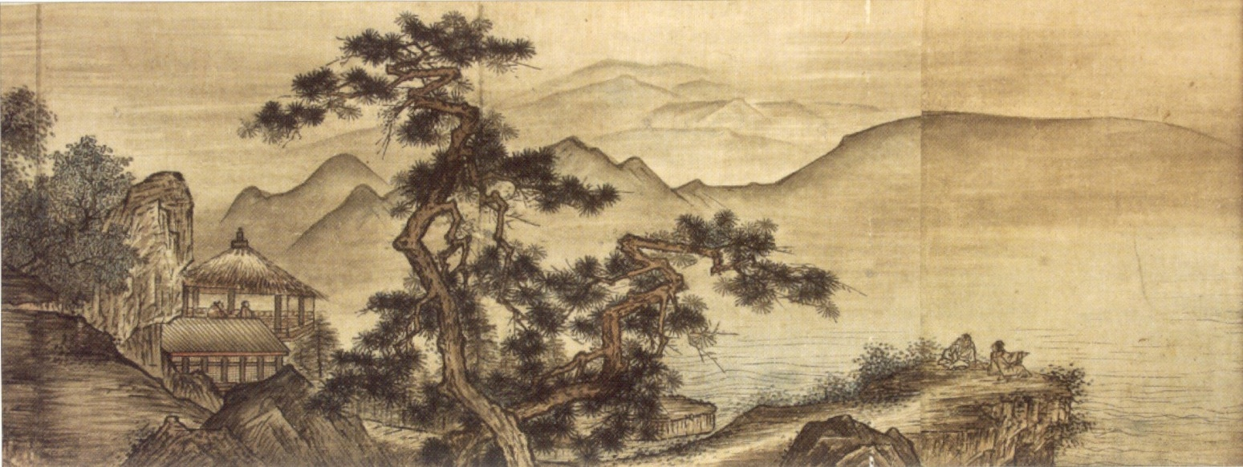
Chinese Art: Natural Influence

Slide 24
Chinese Art: Trends
Chinese painting is fairly stylized in that most paintings include vertical format, negative space, repeated curves, eye-level point of view, few lines and limited color schemes.
These similarities give Chinese art a unique look that has survived through ancient times into the modern art world and characterized a staple in Chinese culture.

Slide 25
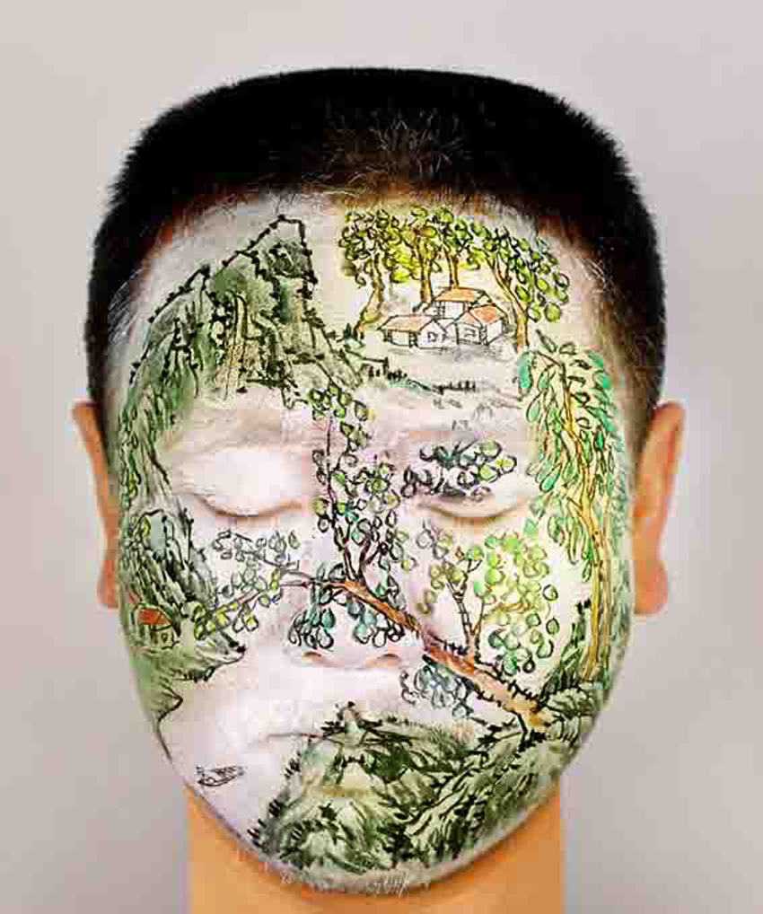
Chinese Influence
Huang Yan paints faces in the style of ancient Chinese paintings. The work contains the traditional linear landscape elements in a contemporary medium.

