Slide 1
Basic Photography Workshop

Slide 2
Composition
Framing Shots
Camera Angles

Slide 3
Happy Snaps vs Artistic Photographs

Slide 4
COMPOSITION
Composition is about creating the picture, we decide what is in it and what is left out.
Through the rules of composition we can create and image that the eye likes and “convince” it to glance at it a moment longer.
The term "composition" means "Putting Together", and that's exactly what we'll do.

Slide 5
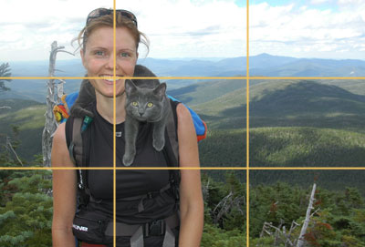
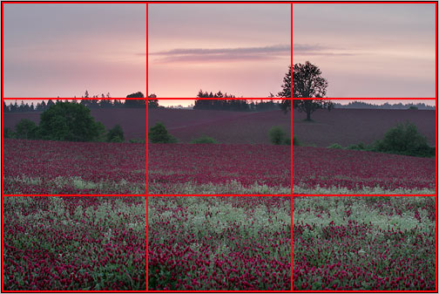
The rule of thirds suggests that you divide your picture frame into thirds, both horizontally and vertically. The best location for the main subject of the photograph is at one of the points where the lines intersect.

Slide 7
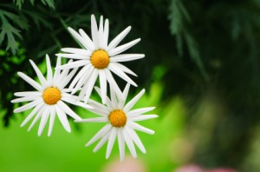
Rule of odds
The "rule of odds" states that by framing the object of interest in an artwork with an even number of surrounding objects, it becomes more comforting to the eye, thus creates a feeling of ease and pleasure.

Slide 8
Space
Consider the impact of space in your photograph.

Slide 9
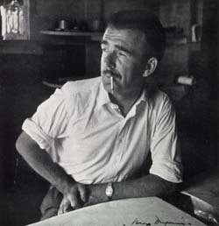
In portrait photographs, if the subject is not looking into the camera but across the frame, more space should be given to the direction of their gaze.

Slide 10
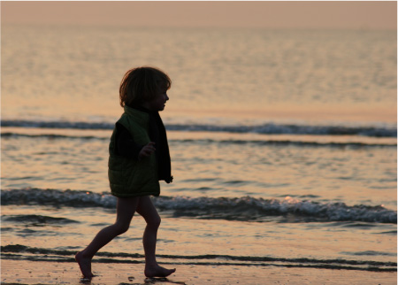
If the subject is moving across the frame leaving space for them to move into enhances the feeling of movement.

Slide 11
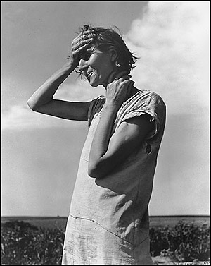
The horizon line should never cut the photograph in half.
Consider having a low or high horizon line.

Slide 12
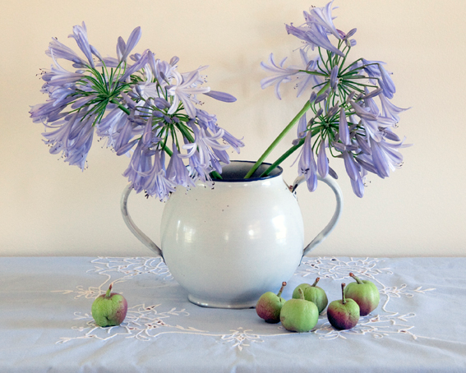
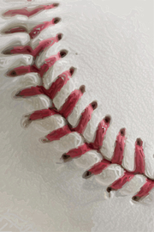
Framing Shots

Slide 13
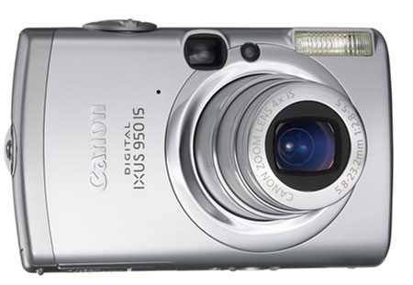
Framing shots
LANDSCAPE
PORTRAIT

Slide 14
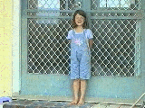
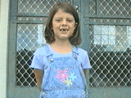
Wide Shot
Mid Shot

Slide 15
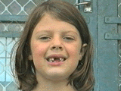
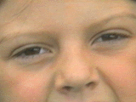
Medium close up
Extreme close up

Slide 16
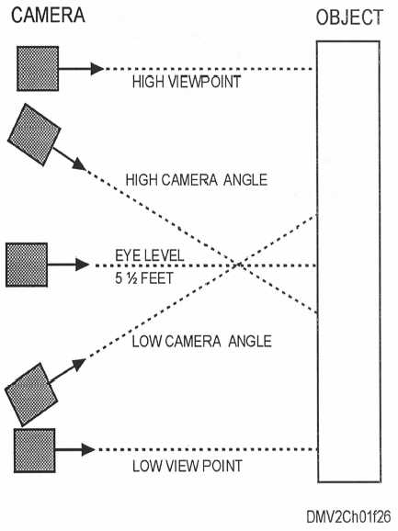
Camera Angles
Changing the camera angle changes the appearance and function of your shot.

Slide 17
Vertical camera angles. Moving the camera around the subject vertically while aiming at the subject creates different camera angles .
Birds Eye View - High angle. The camera is placed above eye level, looking downward. A high angle shot can make a character look smaller, younger, weak, confused, or more childlike.
Eye level. Most commonly used.
Worms Eye View - Low angle. The camera is placed below eye level, looking upward. A low angle shot can make a character look bigger, stronger, or more noble. It also gives the impression of height.

Slide 18
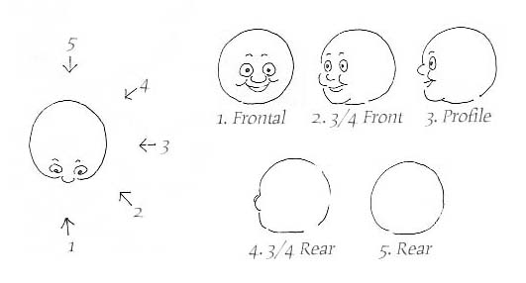
Horizontal Camera Angles.
Moving the camera around the subject horizontally while aiming at the subject creates different camera angles .

Slide 19
Lighting - drama

Slide 20
Dorothy Hodgkin by Maggi Hambling

Slide 21
MEANING
You are going to be making a portrait that tells us about the INTERNAL and EXTERNAL identity of your model. These ‘rules’ of photography are not like ‘laws’ but guides to help you to communicate meaning.

Slide 22
Cartier Bresson

