Slide 1
Process Portfolio/Visual Arts Journal
Revised criteria – ensure you KNOW what is expected…..

Slide 2
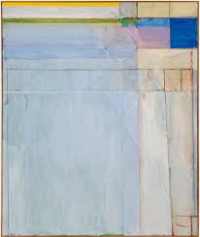
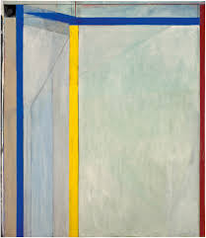
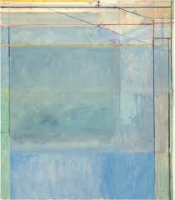
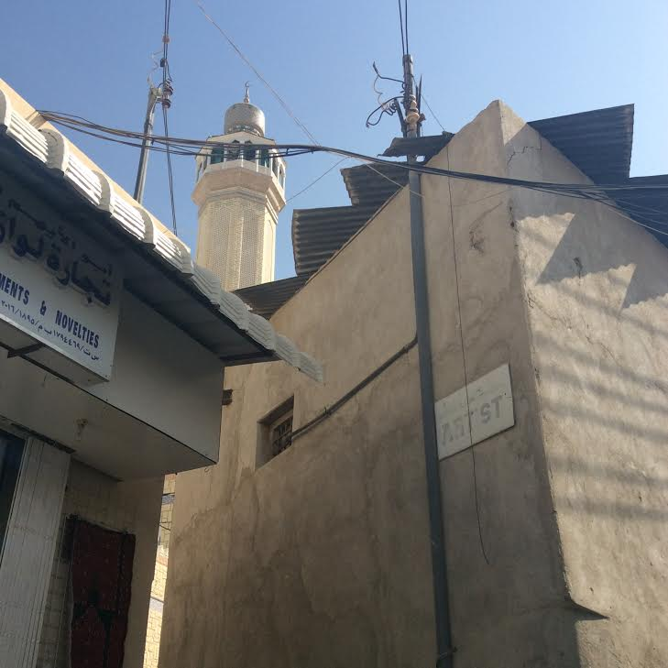
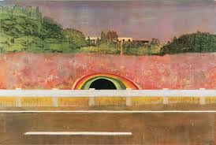
http://www.ocma.net/exhibition/richard-diebenkorn-ocean-park-series
Trip to the souk in Mutrah, Muscat. Using the elements and principles of design to look for source material for an art work.
This sign saying ‘artist’ – a passage with a light at the end – seemed a good place to start….... The arrangement of shape and space was what caught my eye first and led me to take the photograph – it was only after looking more closely I saw the sign.
The geometry and range of hue and surface in the photographs reminded me of the work of Richard Diebenkorn ( 20th Century American). His paintings refer to a wider landscape/place but the way he layers paint and composes could be a useful starting point for my own approach.
“Copying photographs is boring” Peter Doig
https://www.youtube.com/watch?v=rVzxWFRrYD4
Peter Doig is another painter (contemporary Scottish) who layers colour in his work – I must make sure the painting is not simply a ‘copy’ of the photograph but the start of a journey – I want to be surprised …
Kirby Ferguson proposes that a model for creativity is ‘copy, transform, combine’ – I need to make some studies inspired by these artists work.
http://everythingisaremix.info
http://www.contemporaryartcurator.com/peter-doig/

Slide 3
Richard Diebenkorn b. 1922, Portland, OR d. 1993, Berkeley, CA Ocean Park #60 1973 oil on canvas 93 x 81 1/4 in.
Analysis of Diebenkorn painting
Layered colour – evidence of painting being process as per the Bancroft quote ( right) Being able to see the layers underneath – like a map that has been painted over – also the colours are ‘map like’.
Harmonious hues with thin lines of contrasting cadmium yellow and red
Sense of grid like structure – broadly 4 bands or areas – refer to roads/buildings/spaces? but more than that the painting has a compositional ’rightness’ of its own. The source of landscape is the start of a journey where the ‘needs’ of the painting take over – abstraction with root in observation.
Precision and makes you want to look for extended periods of time – it reveals itself . Easy to imagine the movement of the brush – both free/scumbled and controlled.
"He painted and repainted," says Bancroft. "He would scrape away, paint some more. He would focus on one area and decide he would move onto another and destroy something he had worked on for quite a while because he felt like he was treating it too preciously and he identified it as just wanting to get everything right. Everything right. Light, color, space, volume, the whole composition. But he wasn't afraid to show the mistakes.” Sarah Bancroft, Curator Orange county Museum of Art http://www.npr.org/2012/03/02/147722483/in-ocean-park-gentle-portraits-of-california-light
My work – combining my source image and knowledge of Diebenkorn
This developmental study is nearly at the point where the painting could start to follow its own internal logic and really leave the original image behind – but I don’t want to create a Diebenkorn pastiche - the alleyway with the sign saying ‘artist’, clear reference to that particular place is important.
But letting the geometry distort and using harmonious colouration with visibly layered paint is something I want the painting to have.
I think I want the painting to communicate something about a journey to knowledge in some way.
In these pencil sketches I was trying out different spatial arrangements of the elements of the composition. Increasing the convergence of perspective lines and emphasising the rhythmic triangular structures – I would like the viewer to be led to the sign, the light at the end of the passage and then the tower
Diebenkorn was associated with both abstract expressionism and Bay Area Figuration, but actually was following his own agenda throughout his career.

Slide 4
Further experiment with compositional elements and colour- the angle of the tower really helps to increase the sense of upward movement/direction – which .
The red underpainting creates a contrast to the more harmonious blues and greys, but doesn’t help with the central idea I am trying to arrive at of ‘the road less travelled’ leading to some sort of ‘reward’? Or knowledge – but in actual fact the road leads to further challenges – which relates to my favourite artist quote:
“all I have done before the the age of 70 is not worth bothering with. At 75 I'll have learned something of the pattern of nature, of animals, of plants, of trees, birds, fish and insects. When I am 80 you will see real progress. At 90 I shall have cut my way deeply into the mystery of life itself. At 100, I shall be a marvelous artist. At 110, everything I create; a dot, a line, will jump to life as never before. To all of you who are going to live as long as I do, I promise to keep my word. I am writing this in my old age. I used to call myself Hokusai, but today I sign my self 'The Old Man Mad About Drawing.” “
― Hokusai Katsushika
https://www.goodreads.com/author/quotes/264979.Hokusai_Katsushika
The study above is getting closer - the tower is darker, less attainable – the red ‘works’ – with brighter light at the end of the passage this could be ok – the roof of the structure on the left pointing at the sign and the light hitting it also could work – the doorway needs to be angled as well.
I also quite like the turquoise triangles on the central wall as they create ‘steps’ to the tower with pattern and rhythm.

Slide 5
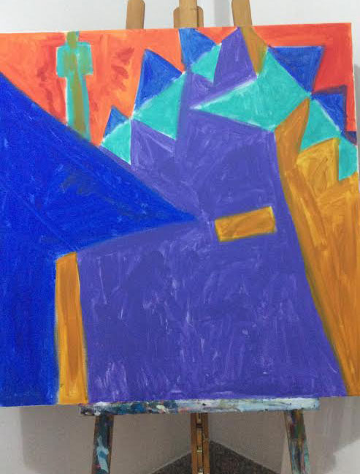
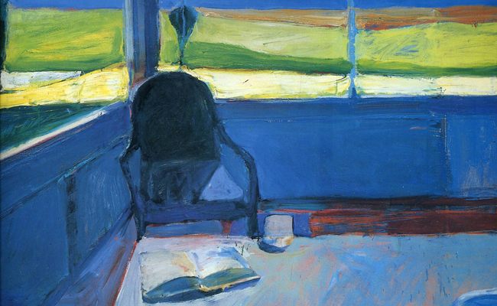
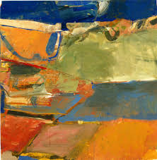
Beginning of my painting – acrylic on canvas – 1mx1m
Placement and angle of tower and edge of building is wrong and need changing to retain the emphasis on upwards direction.
Opposite hues used as base for painting layers on top of, perhaps play with the dynamic between abstraction and representation? – Diebenkorn’s Ocean Park series are abstract yet a result of his earlier painting inquiry into looser more fluid abstractions and more representational paintings of people and objects in his studio, on his porch and the landscape behind his house.
Richard Diebenkorn, Gerald Nordland, Rizzoli Int Publications
Interior with Book 1959
70x64” Oil on canvas
Richard Diebenkorn, Gerald Nordland, Rizzoli Int Publications p 105
Here you can see how the underpainting of opposite hues helps create light and space. Strong contrast – and the way the elements and spaces are arranged gives a clue to the root of the later Ocean Park paintings
One thing that is evident in Diebenkorn’s work is that he was a ‘searcher’ and didn’t stick with a ‘formula’. I like the idea of artistic practice being a journey ( like the Hokusai quote!), it fits with my notion of ‘life long learning.
Diebenkorn says the Ocean Park paintings became more abstract because “ The abstract paintings permit an allover light which wasn’t possible for me in the representational works, which seem somehow dingy by comparison.”
Richard Diebenkorn, Gerald Nordland, Rizzoli Int Publications P.155
In the earlier Berkeley series it is still possible to think of some elements as referring to landscape, but others become less representational and Diebenkorn’s brushwork and layering of paint is more vigorous.
Berkeley no.22 1954 oil on canvas 59x57”
Richard Diebenkorn, Gerald Nordland, Rizzoli Int Publications p 71

