Slide 1
Process Portfolio/Visual Arts Journal
Revised in light of your marking…. Will I do better?!

Slide 2
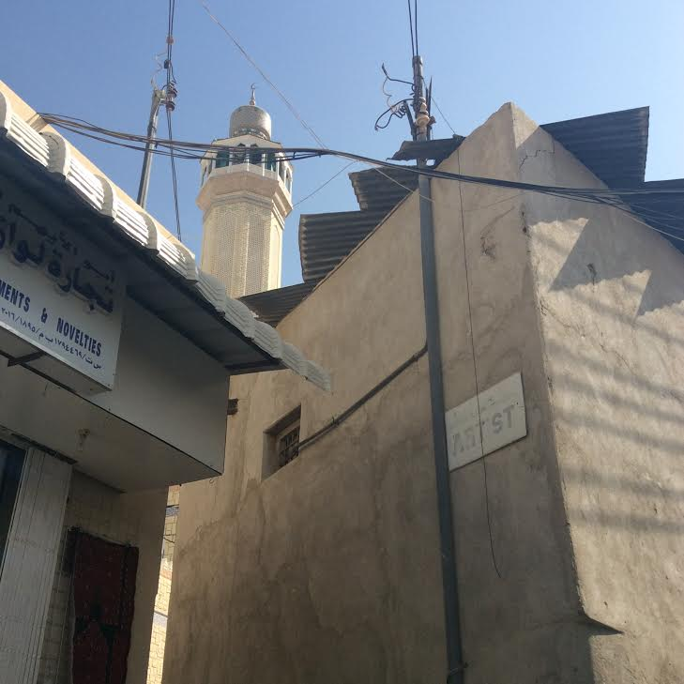
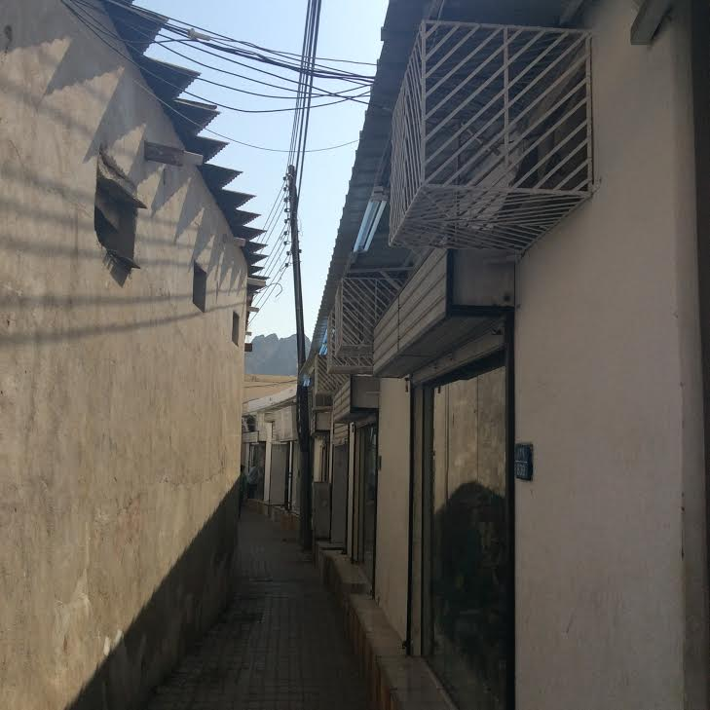
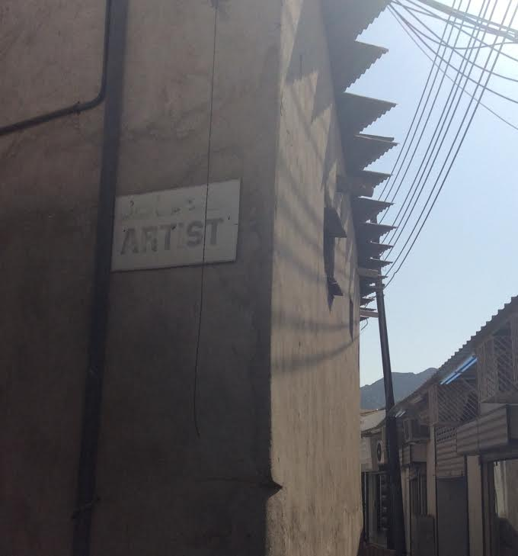
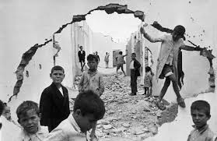
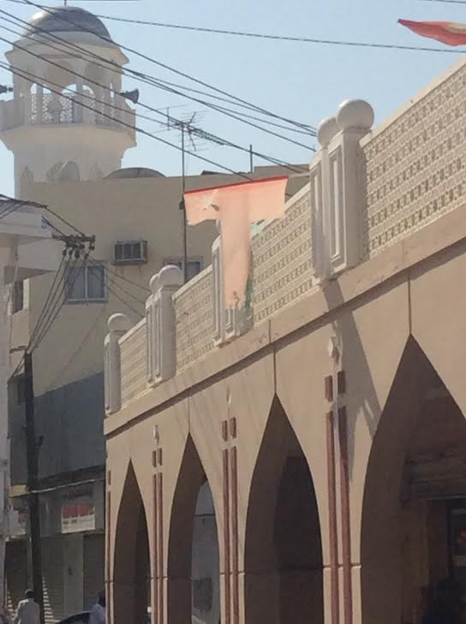
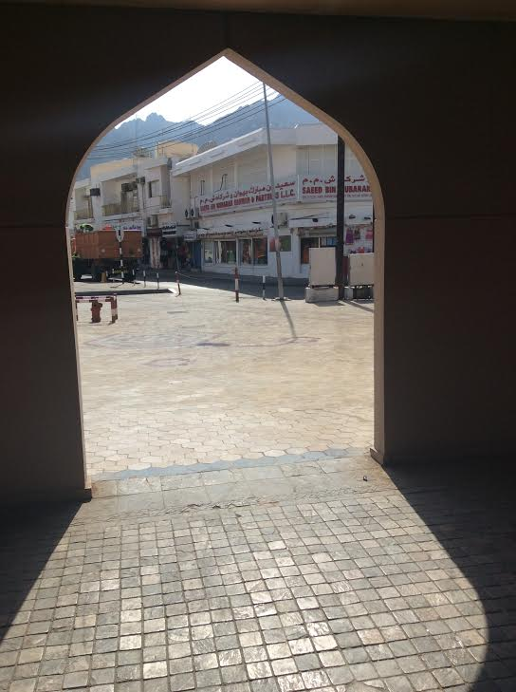
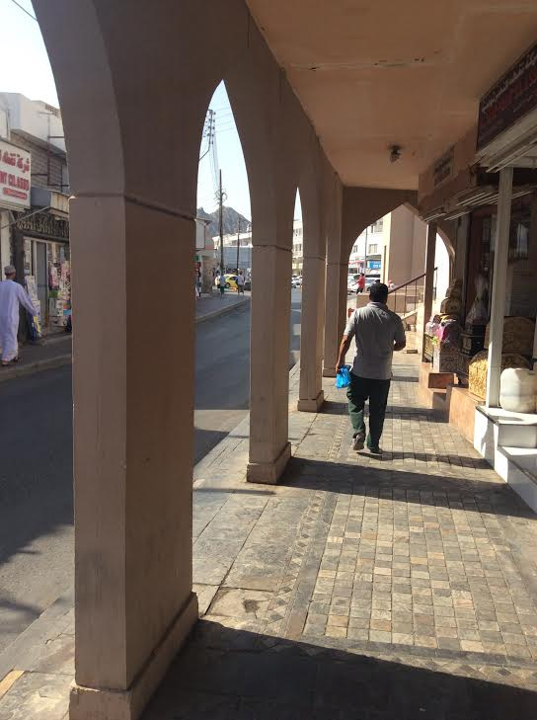
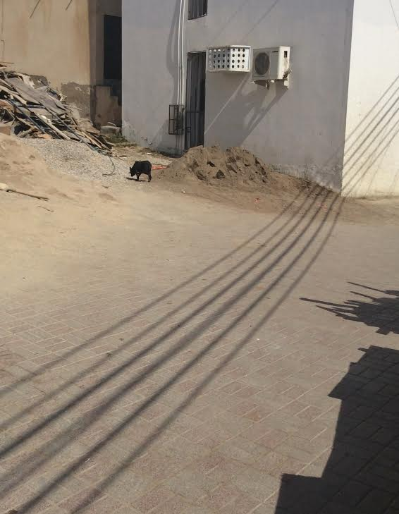
Photography trip – to ’make’ not ‘take’ photographs.
So far I have established that:
Art works often have ‘layers’ of meaning, and through analysis we can ‘unpack’ those meanings – I have examined the work of Richard Diebenkorn and the context of his paintings.
I want my work to be grounded in firsthand experience of the world.
Photography is a complex field in an age where everybody has the ability to take photographs and manipulate them so easily (we are no longer in an age where photographs only ‘memorialise’ a moment in time). I will be editing the photographs and they are a start not an end in themselves.
Photographer Cartier- Bresson said “In order to give a “meaning” to the world, one has to feel involved in what one frames through the viewfinder. This attitude requires concentration, discipline of mind, sensitivity, and a sense of geometry. It is by economy of means that one arrives at simplicity of expression. ”http://www.henricartierbresson.org/en/ I will aim to be sensitive to changes in light, movement, angle of shot, framing, space and composition.
A visit to the Souk will provide opportunities for making photographs that have the potential to be used in artworks that use metaphor, allegory and symbolism to communicate ideas .There is a difference between a ‘happy snap’ and an artistically composed photograph ( making a photograph opposed to taking a photograph)
Henri Cartier-Bresson (1908–2004) is one of the most original, accomplished, influential, and beloved figures in the history of photography. His inventive work of the early 1930s helped define the creative potential of modern photography, and his uncanny ability to capture life on the run made his work synonymous with “the decisive moment”—the title of his first major book. https://www.moma.org/calendar/exhibitions/967
Initial thoughts about my Intention to use this photograph
This sign saying ‘artist’ – a passage with a light at the end – the best photograph I took during the trip. The arrangement of shape, light and space, and the rhythm of repeated forms was what caught my eye first and led me to take the photograph – it was only after looking more closely I saw the sign. This is a promising image that I would like to develop into, possibly, a painting. The inter-locking geometry of the forms and high contrast make a visually compelling composition – painting would allow me to develop the composition and make decisons about what to keep, what to leave out and how to communicate my idea – which at present is to try and make an artwork about what creative inquiry is like. The dark passage way , a ’road less travelled’ as a metaphor for independent thought, with the bright light at the end, and the tower as symbol of knowledge or further heights to climb.
Other shots from the same location – I haven’t edited the images as the colour and contrast are super, but ‘I did choose to frame them as square photographs with the ipad I was using as opposed to the rectangular frame I use earlier.
http://erickimphotography.com/blog/2011/08/22/10-things-henri-cartier-bresson-can-teach-you-about-street-photography/
Some of the other photographs from the trip, all contain spaces to be able to move in to, something to pull the viewer onwards into the space.

Slide 3
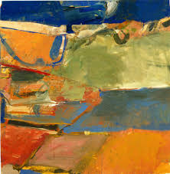
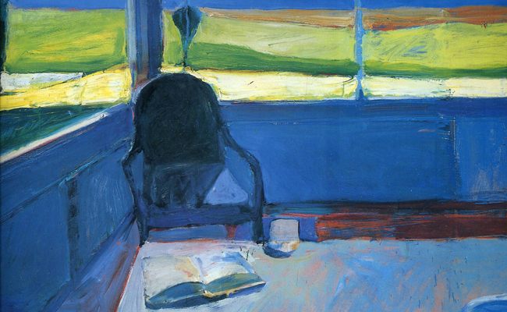
Why Richard Diebenkorn ?
(b. 1922, Portland, OR d. 1993, Berkeley, CA)
His work evolved and changed in different phases of his life, influenced by what he learnt through his artist practice and his location. It was this response to location and his willingness and desire to develop that interest me. I don’t want to be a repetitive artist, I want my work to not be reliant on a ‘style’ that I have mastered, but for it to be a means by which I might know myself and the world around me better.
Diebenkorn was successful and could have stuck with making works like those that had sold previously, but he was a true life long learner and his work is unlike any other that I have seen. Some art histories cite him as a ‘Bay Area Figurative Painter’, other as an ‘Abstract Expressionist’, but his work was not following a path as part of a group philosophy, the way his work changes in use of colour, application of paint, use of space, geometry and switches between the objective and non-objective was independent. This fits with the intended meaning of the work I hope to make – so maybe my work will not only be about the importance of being an independent creative thinker as an artist, but also is critical of art that follows trends?
"He painted and repainted. He would scrape away, paint some more. He would focus on one area and decide he would move onto another and destroy something he had worked on for quite a while because he felt like he was treating it too preciously and he identified it as just wanting to get everything right. Everything right. Light, color, space, volume, the whole composition. But he wasn't afraid to show the mistakes.”
Sarah Bancroft, Curator Orange county Museum of Art
http://www.npr.org/2012/03/02/147722483/in-ocean-park-gentle-portraits-of-california-light
Richard Diebenkorn Ocean Park #60 1973 oil on canvas 93 x 81 1/4 in.
Like other Ocean Park paintings Diebnkorn used layers of colour in no.60– evidence of painting being a process as per the Bancroft quote (above right). We can see the painting underneath – like a map that has been painted over – also the colours used are ‘map like’.
There are harmonious hues of greens and turquoises with thin lines of contrasting cadmium yellow, ochres and red
There is a great sense of space and light. Diebenkorn said the Ocean Park paintings became more abstract because
“ The abstract paintings permit an allover light which wasn’t possible for me in the representational works, which seem somehow dingy by comparison.”
Richard Diebenkorn, Gerald Nordland, Rizzoli Int Publications P.155
In Ocean Park no.60 there is an underlying grid like structure – broadly 4 bands or areas – the geometry of the composition originally referred to roads/buildings/real spaces but more than that the painting has a compositional ’rightness’ of its own. The source of landscape is the start of a journey where the ‘needs’ of the painting take over – it is abstraction with its roots in observation.
There is both a precision to the composition and a freedom in the way the paint is applied in scumbled layers.
I also want my artwork to develop in this way – to have the photograph as a starting point but to learn from Diebenkorn’s approach to allow my painting to evolve in and of itself.
Berkeley no.22 1954 oil on canvas 59x57”
Richard Diebenkorn, Gerald Nordland, Rizzoli Int Publications p 71
Interior with Book 1959
70x64” Oil on canvas
Richard Diebenkorn, Gerald Nordland, Rizzoli Int Publications p 105
Diebenkorn’s work occurred in series or phases, and some of these are named after the place he was living at the time – Urbana, Berkeley, Ocean Park etc
His earliest works are very figurative and are influenced by artists like Edward Hopper, but was introduced to more abstract modernist works at University whilst still conscripted in the army. By the late 1940’s his work fitted very neatly into the nascent Abstract Expressionist art being produced in the US art world. Richard Diebenkorn, Gerald Nordland, Rizzoli Int Publications p.15-16

Slide 4
Developing my piece using what I have learnt from Diebenkorn’s process.
The developmental study using acrylic on paper on the left is nearly at the point where the painting could start to follow its own internal logic and really leave the original image behind – but I don’t want to create a Diebenkorn pastiche - the alleyway with the sign saying ‘artist’, clear reference to that particular place, is important.
But letting the geometry distort and using harmonious colouration with visibly layered paint is something I want the painting to have.
Experimentation with composition
In these initial pencil sketches above I was trying out different spatial arrangements of the elements of the composition. Increasing the convergence of perspective lines and emphasising the rhythmic triangular structures – I would like the viewer to be led to the sign, the light at the end of the passage and then the tower
Each variation of negative space, colouration and placement of the elements of the composition presents different atmosphere – the one above is the closest so far to my intention - I used it to make the larger study on the right.
The study above is getting closer - the tower is darker, less attainable – the red ‘works’ – with brighter light at the end of the passage this could be ok – the roof of the structure on the left pointing at the sign and the light hitting it also could work – the doorway needs to be angled as well.
I also quite like the turquoise triangles on the central wall as they create ‘steps’ to the tower with pattern and rhythm.

Slide 5
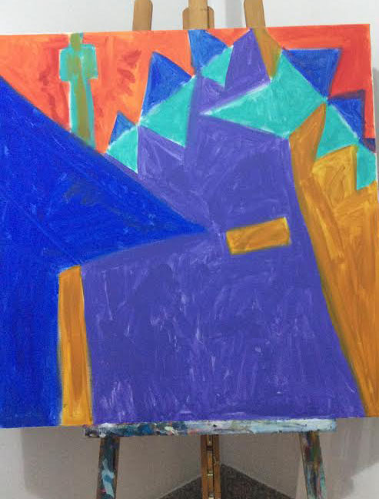
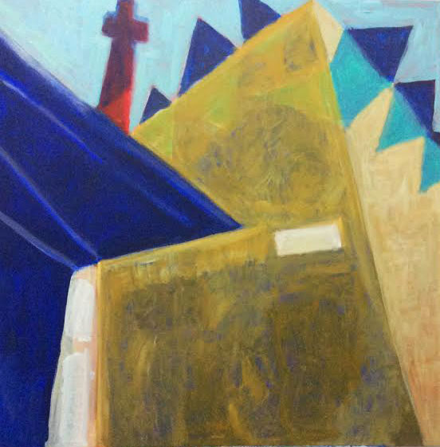
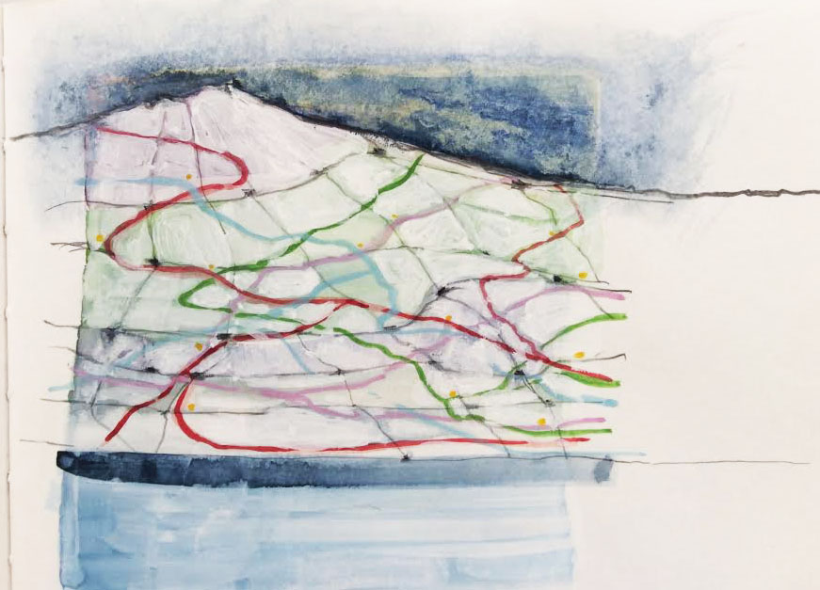
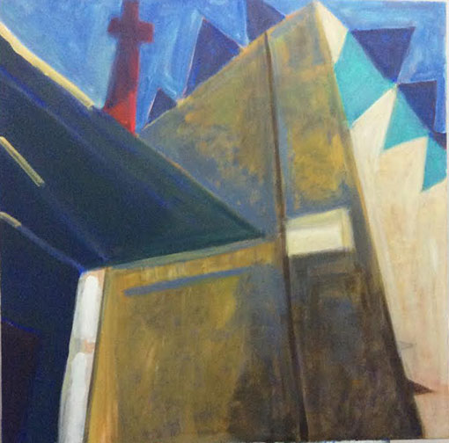
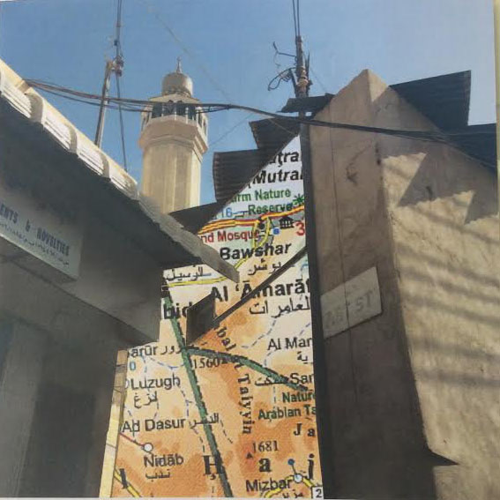
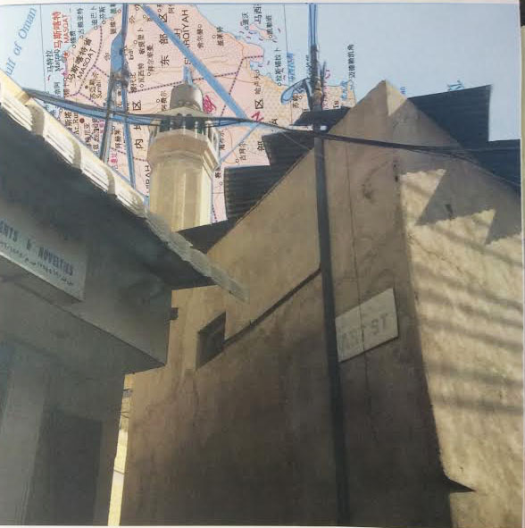
Reflection on start of painting
I began putting the first base colour in acrylic on a canvas 1m x 1m ( right )– like in the Diebenkorn Interior with a chair 1959 I have used the hues that are opposite to those I will use – seeking to get the same ‘allover light” that he spoke of.
I have not got the triangular upward recession of perspective I wanted and will have to re-paint the position of the tower and the edge of the building on the left.
Second ‘pass’ of paint – still need to get the edges of the buildings to create steeper angles – sign needs to be angled more.
Decisions about next step:
Adopt ‘beyond representation’ approach?
Use map idea?
Stick to original idea of journey to knowledge and refine composition to this end?
Refining/development of idea
I have experimented with using maps as part of the composition - I found a map of Oman in Chinese. Having moved here from Dalian in N E China I thought perhaps I could show not only where I am but where I have been.
Does this go off at too much of a tangent from the original idea of a journey to knowledge and independent creative inquiry?
I quite like the idea of mapping as an analogy for art making – maps are abstract objects that share information using conventions collectively understood by a culture and often require a ‘key’ to de-code.
Having noted the ‘map like’ colours in some of the Ocean Park series I went back to a sketch I made previously (above) – I was thinking about how hard it is to actually comprehend a landscape. When you try and depict and understand its structure - it is like we mentally map it – maybe all art is like a map – it shows the way we have thought at something. Diebenkorn’s work are abstractions but have their source in paintiings/images of a specific place
Ocean Park 60 Richard Diebenkorn, Gerald Nordland, Rizzoli Int Publication
Third ‘pass’ of paint – I need to make some decisions about which way to go - I might need to make the angle of the roof steeper as well.

