Slide 1
Stanley Spencer
British artist
1891-1959

Slide 2
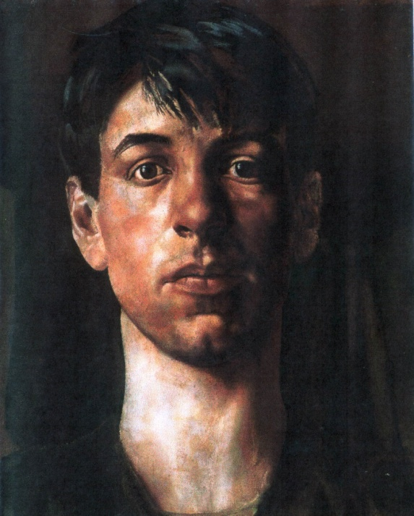
Self portrait 1914

Slide 3
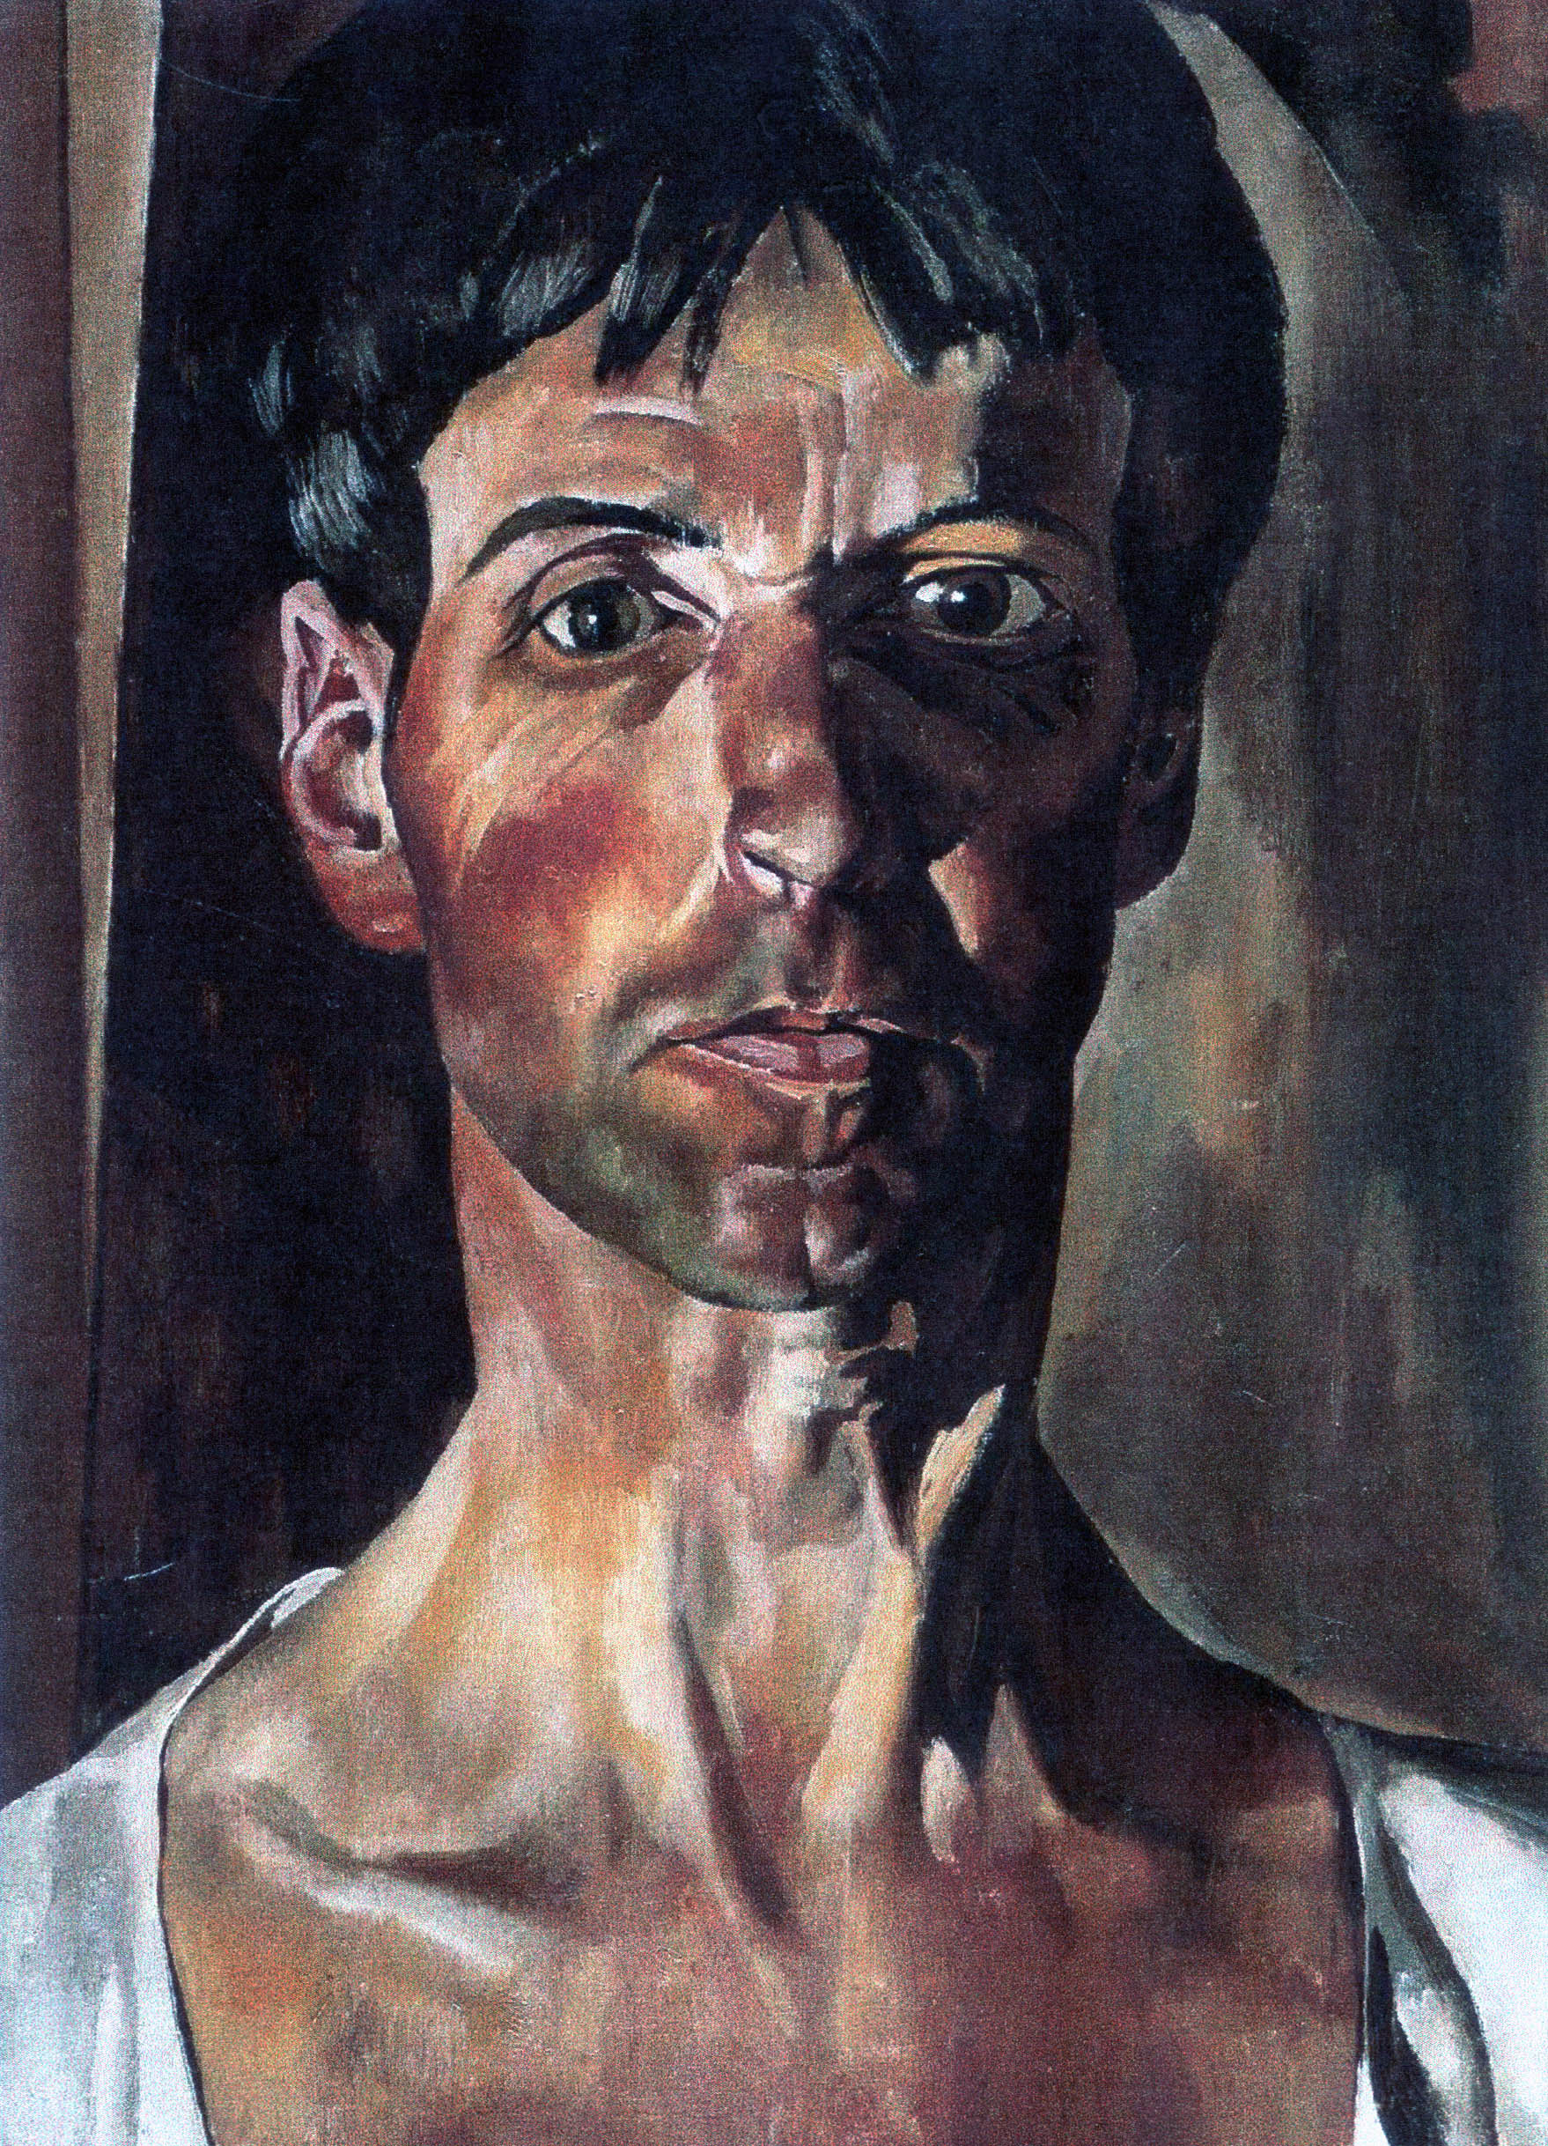
Self portrait 1936

Slide 4
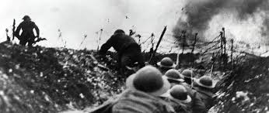
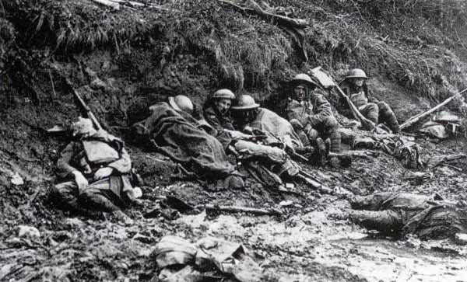
World War 1 1914-18 17 million dead 20 million wounded

Slide 5
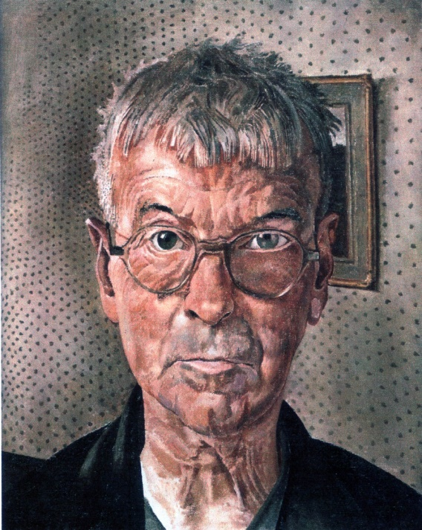
Self portrait 1959

